Slide 1

Fixed Width is Broken – Responsive Site Design
John Watts
Julie Hayes

Slide 2
Agenda
Introductions
Objectives
What is Responsive Site Design
Why Responsive?
Hands on!

Slide 3



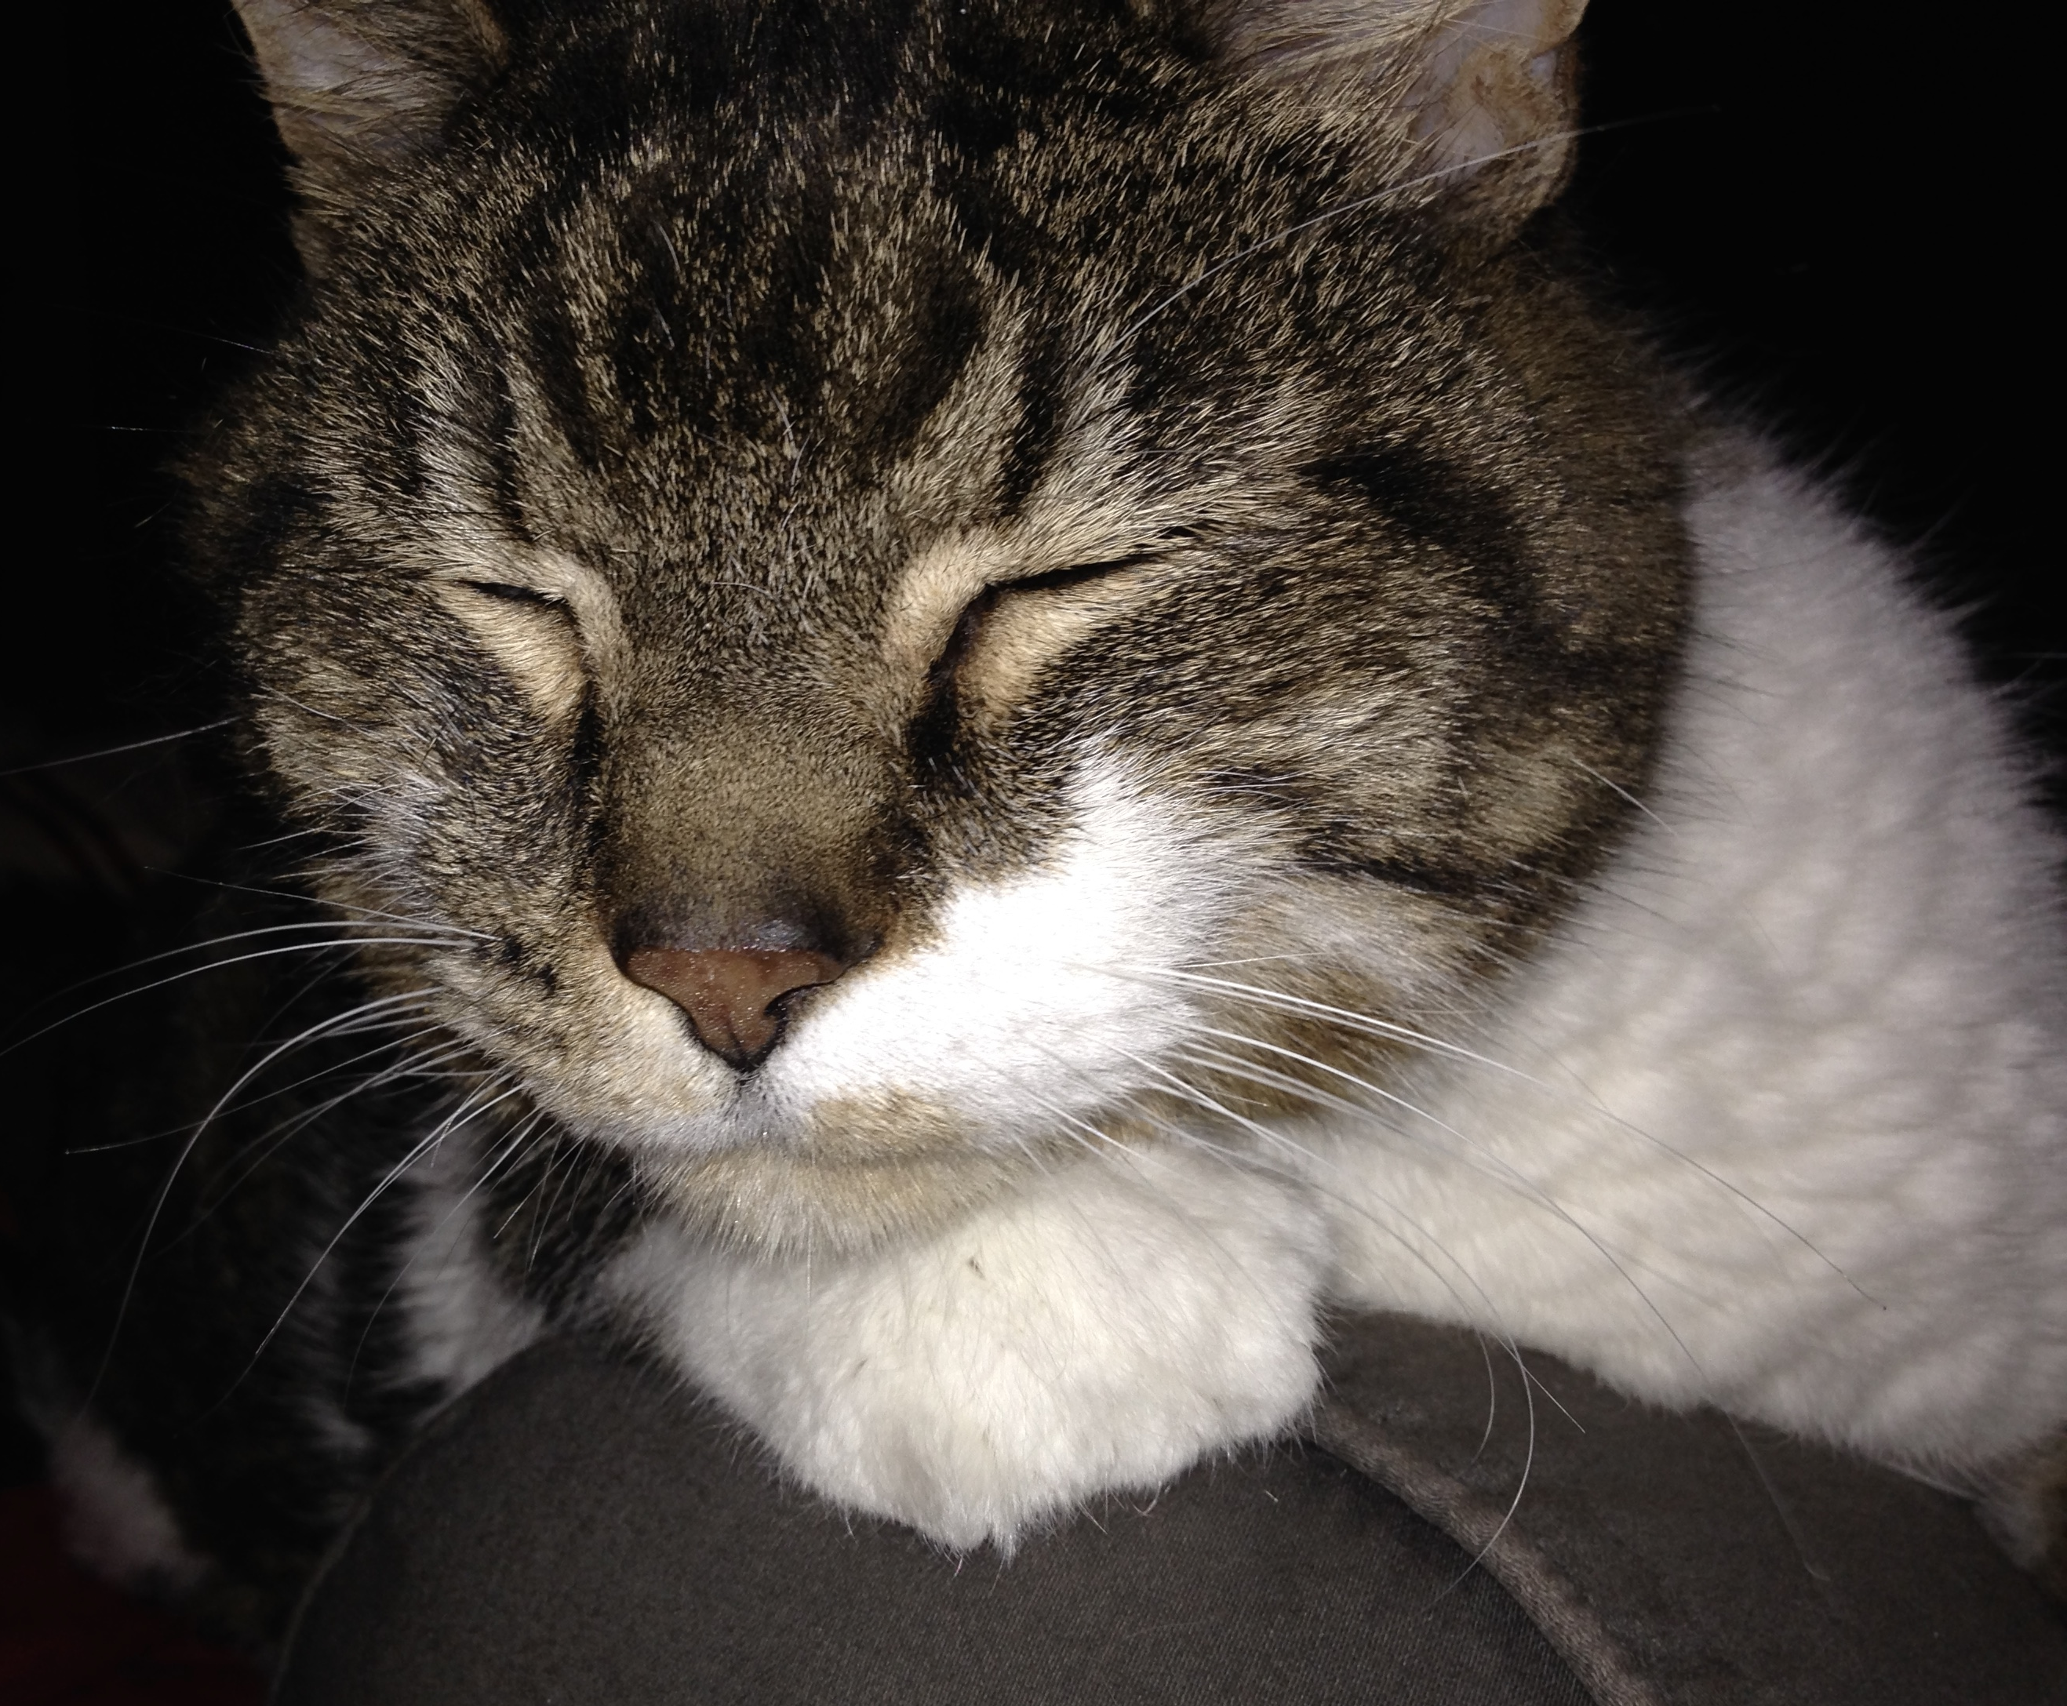
Introductions
Julie Hayes
Customer Success Manager / Product Manger @ Evergage
Startup Institute Alumna (Ask me any questions you have!)
8 years of intermittent HTML/CSS coding
N00b JavaScripter
Mom to a 19 year-old Maine Coon
Avid Packer fan
Notes:
KEY TALKING POINTS .
Lots of challenges facing today’s marketers.
Here are some examples
SAMPLE SCRIPT
There are many challenges today’s digital marketers are facing. Whether it’s the need to drive more leads, generate more sales on your site, increase page views, or improve customer loyalty and retention -- just to name a few.

Slide 4
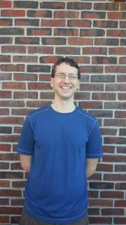
Introductions
Notes:
KEY TALKING POINTS .
Lots of challenges facing today’s marketers.
Here are some examples
SAMPLE SCRIPT
There are many challenges today’s digital marketers are facing. Whether it’s the need to drive more leads, generate more sales on your site, increase page views, or improve customer loyalty and retention -- just to name a few.

Slide 5

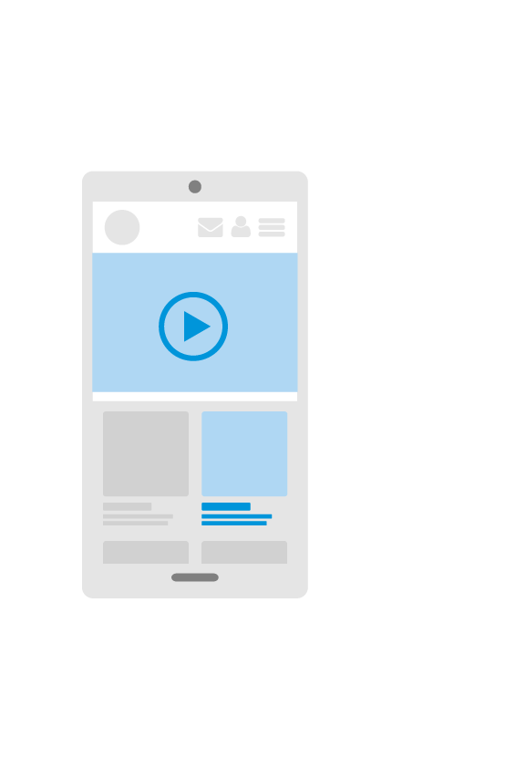
What is Responsive Site Design
Examples of Non-Responsive (Julie)
Fixed width site
How it looks on mobile
Desktop site on phone
pop-ups that expand beyond the edges of device
Examples of good design
Bootstrap
Notes:
KEY TALKING POINTS
$121B spent on digital advertising in 2014
Yet, typical bounce rates of 50-70%, 1-3% conversion rates, and 60-80% cart abandomment (eComm)
There’s clearly room for improvement – and personalization will help
SAMPLE SCRIPT
Marketers spend a lot of time, energy and resources to get people to their websites – using tactics like email, content marketing, SEO, adwords, pay-per-lead programs, etc. – but they often neglect to optimize the experience once users arrive at their site!
[KEY STAT] TechCrunch reported that marketers will spend $121 billion in 2014 on digital advertising.]
Yet when people come to the website, it’s pretty typical to see 50-70% bounce rates, 1-3% conversion rates, or for ecommerce sites to have 60-80% cart abandonment rate. Needless to say, there is a LOT of room for improvement.
That’s why digital marketers are starting to pay so much attention to personalization these days.
[KEY STAT] In fact, according to an Adobe 2014 survey, respondents targeting more than 20% of their visitors with personalized content achieved a 5% conversion rate, which was 2x the average conversion rate of 2.5% in their study.

Slide 6
How to do Responsive Site Design
Examples of Non-Responsive (Julie)
Fixed width site
How it looks on mobile
Desktop site on phone
pop-ups that expand beyond the edges of device
Examples of good design
Bootstrap
Notes:
KEY TALKING POINTS
$121B spent on digital advertising in 2014
Yet, typical bounce rates of 50-70%, 1-3% conversion rates, and 60-80% cart abandomment (eComm)
There’s clearly room for improvement – and personalization will help
SAMPLE SCRIPT
Marketers spend a lot of time, energy and resources to get people to their websites – using tactics like email, content marketing, SEO, adwords, pay-per-lead programs, etc. – but they often neglect to optimize the experience once users arrive at their site!
[KEY STAT] TechCrunch reported that marketers will spend $121 billion in 2014 on digital advertising.]
Yet when people come to the website, it’s pretty typical to see 50-70% bounce rates, 1-3% conversion rates, or for ecommerce sites to have 60-80% cart abandonment rate. Needless to say, there is a LOT of room for improvement.
That’s why digital marketers are starting to pay so much attention to personalization these days.
[KEY STAT] In fact, according to an Adobe 2014 survey, respondents targeting more than 20% of their visitors with personalized content achieved a 5% conversion rate, which was 2x the average conversion rate of 2.5% in their study.

Slide 7
How to do Responsive Site Design
Terms
Grid System
Media Queries
Breakpoints
Progressive Enhancement
Mobile First
Notes:
KEY TALKING POINTS
$121B spent on digital advertising in 2014
Yet, typical bounce rates of 50-70%, 1-3% conversion rates, and 60-80% cart abandomment (eComm)
There’s clearly room for improvement – and personalization will help
SAMPLE SCRIPT
Marketers spend a lot of time, energy and resources to get people to their websites – using tactics like email, content marketing, SEO, adwords, pay-per-lead programs, etc. – but they often neglect to optimize the experience once users arrive at their site!
[KEY STAT] TechCrunch reported that marketers will spend $121 billion in 2014 on digital advertising.]
Yet when people come to the website, it’s pretty typical to see 50-70% bounce rates, 1-3% conversion rates, or for ecommerce sites to have 60-80% cart abandonment rate. Needless to say, there is a LOT of room for improvement.
That’s why digital marketers are starting to pay so much attention to personalization these days.
[KEY STAT] In fact, according to an Adobe 2014 survey, respondents targeting more than 20% of their visitors with personalized content achieved a 5% conversion rate, which was 2x the average conversion rate of 2.5% in their study.

Slide 8
Demonstration
Notes:
OUTLINE FOR INTRODUCTORY DEMO
1. Show demo website (visitor’s experience) and point out personalizations in action.
2. Open Visual Editor using Chrome extension
a. Describe/show campaigns & experiences & messages/page changes
b. Define a sample area on the page to personalize (reference a personalization they saw in step 1 “behind the scenes”)
c. Describe/show A/B testing (in a separate campaign)
d. (optional) Show how to track an action like a form field/search bar or obscure widget click (so doesn’t look like something have to do often)
3. Open Evergage Platform
a. Show existing segment example (ideally for a personalization shown in step 1)
b. Show how it’s marketer-oriented (select criteria and show AND/OR logic)
c. (for content/ecomm) Show rule-based promotion
4. Show Dashboard / Reports
a. Show existing report examples (with data populated)
b. Show a campaign lift results example

